Slide 1
Seasonality and trading days tests in JD+
ESTP Training
05-07 October 2026

Slide 2
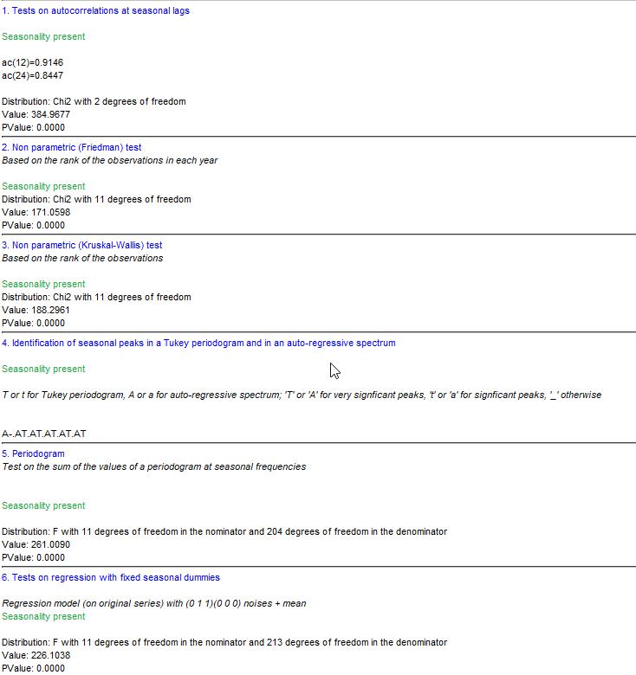
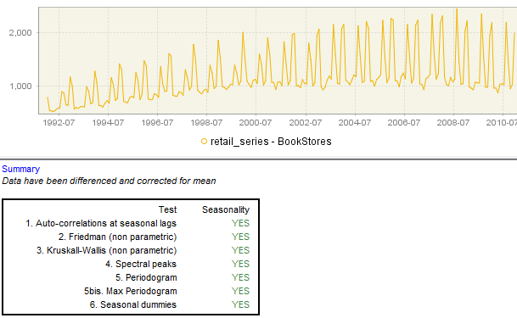
Overview

Slide 3
Seasonality tests
Non-parametric tests
  Applied on series without trend (for instance (log) differenced series)
  Friedman
    ANOVA-type. The test uses the rankings of the observations within each year. It does not require distributional assumptions.
    H0: all periods can be treated equally (= no seasonality), H1: series is seasonal
  Kruskall-Wallis
    The test uses the rankings of all the observations. It does not require distributional assumptions.
    H0: All periods have the same mean(average ranking), H1: series is seasonal

Slide 4
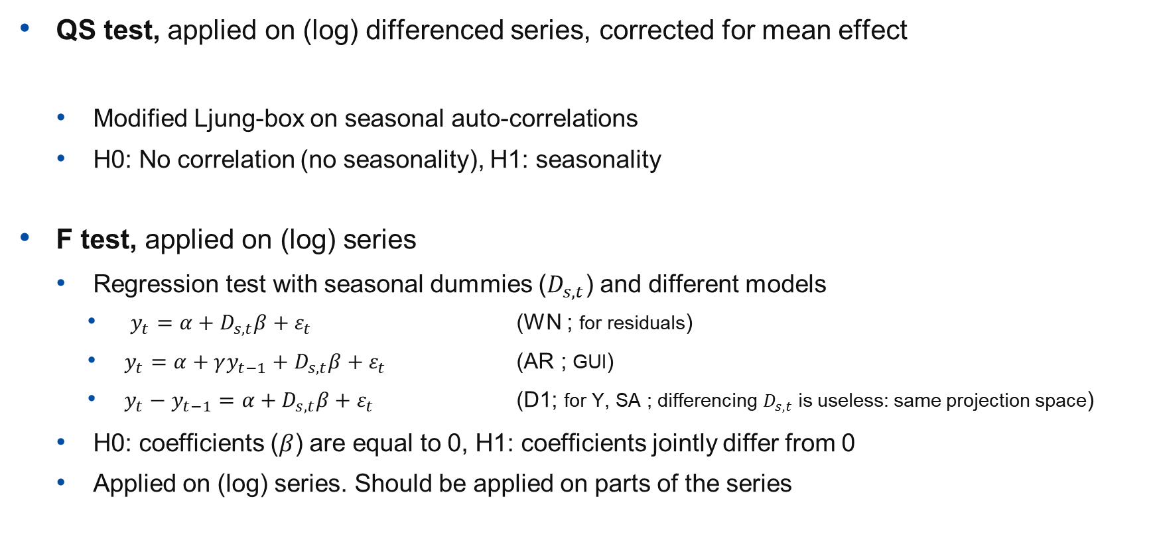
Seasonality tests (cont.)
QS test, applied on (log) differenced series, corrected for mean effect
  Modified Ljung-box on seasonal auto-correlations
  H0: No correlation (no seasonality), H1: seasonality
F test, applied on (log) series
  Regression test with seasonal dummies ($D_{s,t}$) and different models
    $y_{t}={α+D}_{s,t}β+ε_{t}$ (WN ; for residuals)
    $y_{t}=α+γy_{t−1}+D_{s,t}β+ε_{t}$ (AR ; GUI)
    $y_{t}−y_{t−1}=α+D_{s,t}β+ε_{t}$ (D1; for Y, SA ; differencing $D_{s,t}$ is useless: same projection space)
  H0: coefficients ($β$) are equal to 0, H1: coefficients jointly differ from 0
  Applied on (log) series. Should be applied on parts of the series

Slide 5
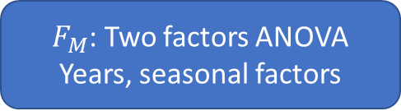
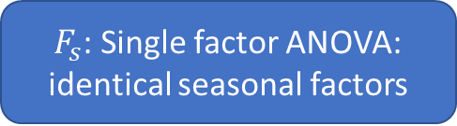

Seasonality tests (cont.)
Combined seasonality test (X11-like)
$F_{s}$: Single factor ANOVA:
identical seasonal factors
$F_{M}$: Two factors ANOVA
Years, seasonal factors
P-value<0.1
$$f(F_{S},F_{M})$$
P-value<0.1
Kruskal-Wallis
(non parametric)
No identifiable seasonality
Probably no identifiable seasonality
Identifiable seasonality

Slide 6
Seasonality tests (cont.)
Spectral diagnostics
  Spectral peaks (X13-like)
    Based on the spectrum of a long auto-regressive model that fits the series (see X13 documentation)
  Periodogram
    Performed on the periodogram (Fourier transformation) of the series at the Fourier frequencies.
      maximum of the periodogram on or around the seasonal frequencies
      sum of the values of the periodogram on or around the seasonal frequencies
    Strictly speaking, only valid against the hypothesis that the (transformed) series is a white noise. As the spectral peaks, they don’t perform well for short series.

Slide 7
Seasonality tests (cont.)
Canova-Hansen test (R only)
  test the stability of the coefficients of seasonal regressors (model quite like the F-test), using a Lagrange multiplier test.
  H0: stable seasonal pattern (no seasonality ≡ stable 0 coefficients).
  H1: seasonal unit roots.
  P-values computed numerically for small samples.

Slide 8
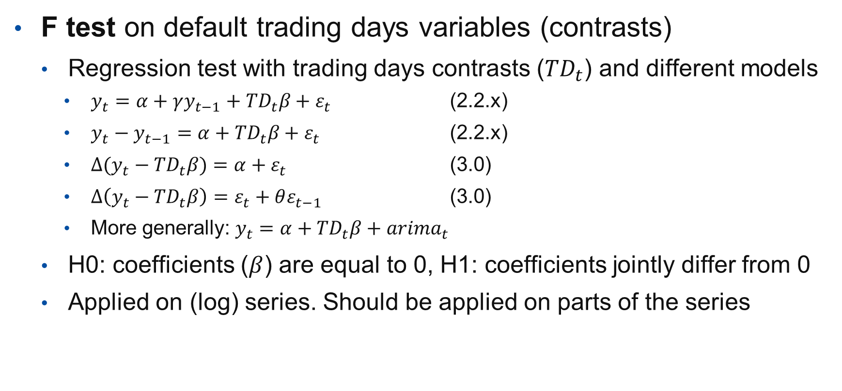
Trading days tests
F test on default trading days variables (contrasts)
  Regression test with trading days contrasts (${TD}_{t}$) and different models
    $y_{t}=α+γy_{t−1}+{TD}_{t}β+ε_{t}$ (2.2.x)
    $y_{t}−y_{t−1}=α+{TD}_{t}β+ε_{t}$ (2.2.x)
    $∆(y_{t}−{TD}_{t}β)=α+ε_{t}$ (3.0)
    $∆\left(y_{t}−{TD}_{t}β\right)=ε_{t}+θε_{t−1}$ (3.0)
    More generally: $y_{t}=α+{TD}_{t}β+{arima}_{t}$
  H0: coefficients ($β$) are equal to 0, H1: coefficients jointly differ from 0
  Applied on (log) series. Should be applied on parts of the series

Slide 9
Trading days tests(cont.)
Canova-Hansen test on trading days variables (R only)
  test the stability of the coefficients of trading days, using a Lagrange multiplier test.
Likelihood ratio test on time varying trading days coefficients (R only)
  rjd3toolkit >= 3.2.5

Slide 10
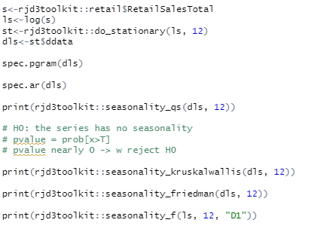
Seasonality tests in R

Slide 11
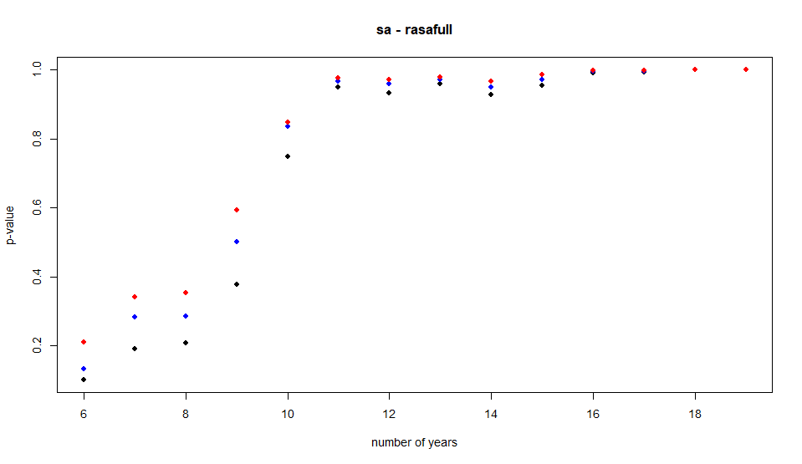
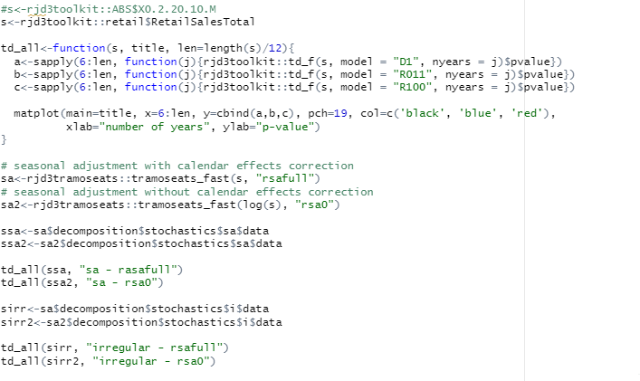
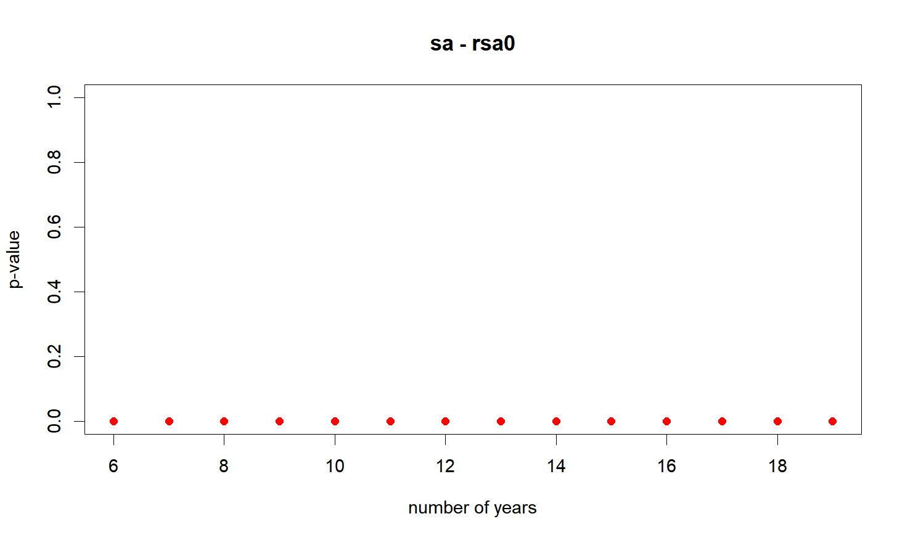
Trading days tests in R

